Slide 1
Python Workshop I: The Very Basics
Data Services
February 2020

Slide 2
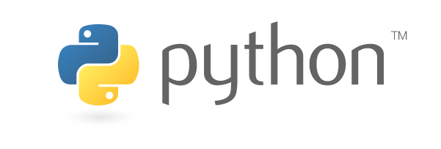
Workshop Agenda
Overview of Python
Overview of Jupyter Notebooks
Access Python
Python
Anaconda
Google Collab
Try out Python
Simple arithmetic
Variables
Input data from web source

Slide 3
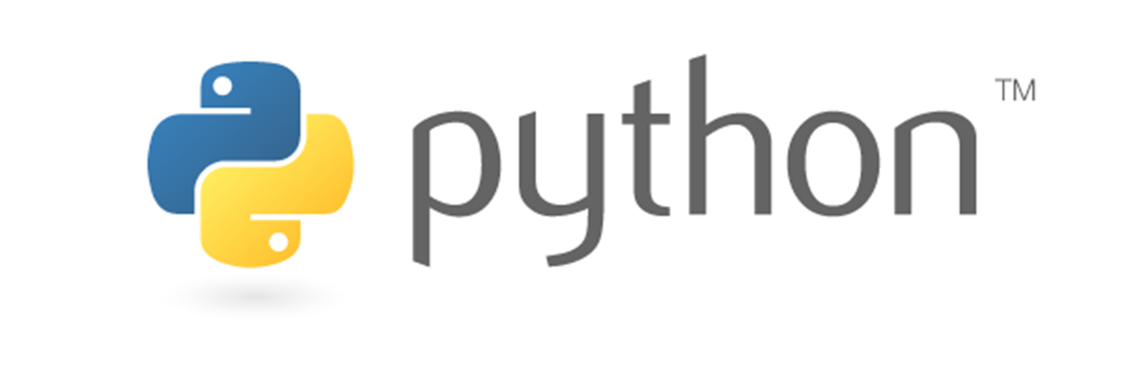
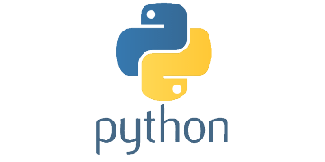
What is Python?
Python is a high-level coding language for programming
Constructed from more fundamental coding language
Uses
Programming
Data Science
Machine Learning/AI
Raspberry Pi
Much more!

Slide 4
Opening Python
If you do not have Python or Anaconda already installed on your computer, use Google Collab – we will get to that later

Slide 5
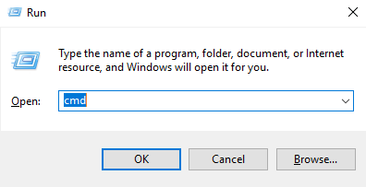
Opening in Windows
To access Python on your personal computer
Open Command Prompt (Windows+r) | Type cmd | hit enter
Type – python
Does Python open? If not, and you know you have it – Path Variable Issue – Use Google Collab
If python turns on – exit()

Slide 6
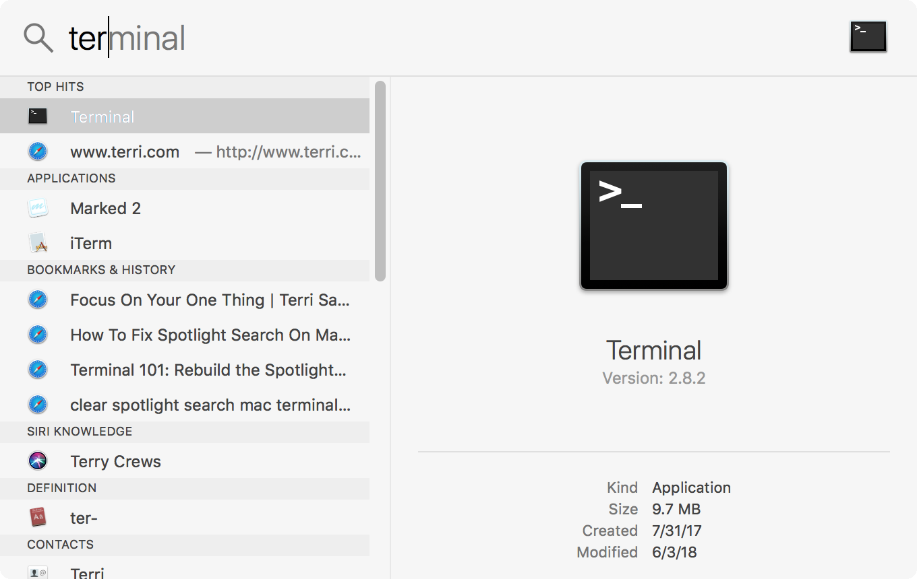
Opening on Mac
Command + Space Bar
Type terminal
Type python
Does Python open? If not and you know you have it – Path Variable Issue – Use Google Collab
If python turns on – exit()

Slide 7
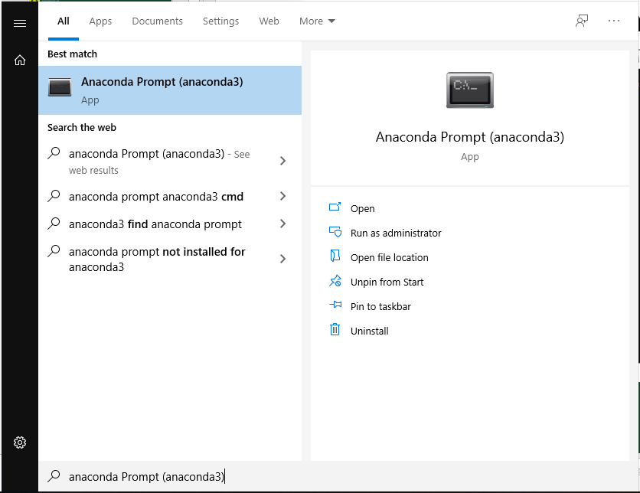
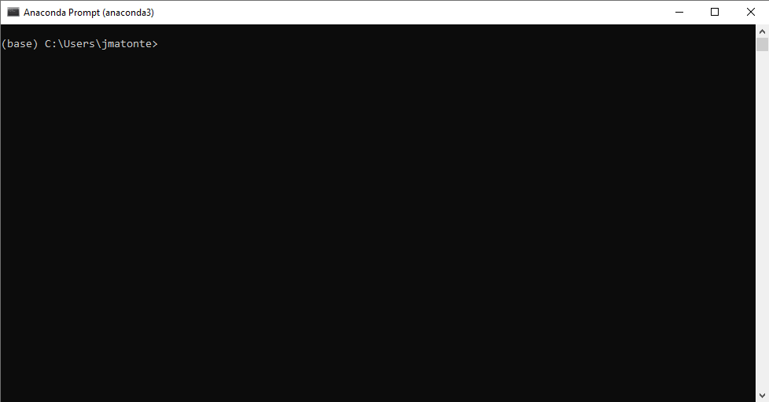
Alternative: Anaconda Prompt
Search or find Anaconda Prompt and open

Slide 8

Google Colab – Synthetic Python Environment
Do not have Python or Anaconda
Google “google colab”
Files are saved to your Google Drive
Can also open preexisting Python files on your computer

Slide 9
Create New Folder for Python Work
On Desktop, or wherever you prefer, create a new file – I suggest naming it something like “python_workshop”
Next we will route our work to this new folder via Command Prompt or Terminal
cd to file directory
Windows - cd “filepath”
Mac – cd filepath

Slide 10

Jupyter Notebooks
To use Python in a more friendly environment, we will use Jupyter Notebooks
pip install jupyter OR pip3 install jupyter OR conda install jupyter (if in Anaconda)
Do not have pip? (curl https://bootsrap.pypa.io/get-pip.py -o get-pip.py)
Open Jupyter notebooks
jupyter notebook

Slide 11
Navigating Jupyter Notebooks
Opens Chrome webpage
Files and content can be saved anywhere, both on your computer or the cloud
Easy to navigate
Cells
Preformatted syntax
Google Colab -- very similar

Slide 12
What is code and how to code
In Python, and many other software, coding is calling on premade functions, also known as “canned” functions.
These functions are made in an even more elementary code, such as C++
Python uses common words for its canned procedures
We can also call on packages that perform specific functions
matplotlib – ploting graphs and charts
Numpy – numerical operations
Pandas – data frame manipulation
gdal - GIS
json – interpreting json formatted data
Many, many more

Slide 13
Let’s try it out!
https://github.com/JMUO/PythonWorkshopSeries
Tips
To reopen a Jupyter Notebook, just launch Jupyter Notebook again designating the file directory you used initially
Having issues with importing Bob Ross data? Try pip install certifi This provides Python with the right certificates.

Slide 14
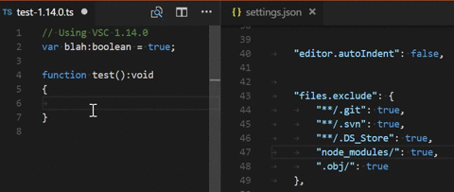
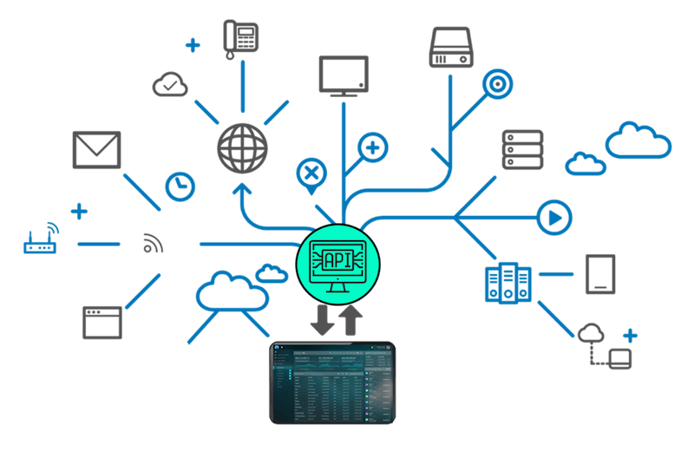
Looking Forward
Python Workshop II – Applied Python
APIs
JSON

